Slide 1
Maximum Flow
Chaklam Silpasuwanchai

Slide 2
Readings
Chapter 24, Maximum Flow, Cormen et al. (2009). Introduction to Algorithms, Third Edition (3rd ed.). The MIT Press.
Design and Analysis of Algorithms, MIT - https://ocw.mit.edu/courses/electrical-engineering-and-computer-science/6-046j-design-and-analysis-of-algorithms-spring-2015/
Douglas Wilhelm Harder, Waterloo University - https://ece.uwaterloo.ca/~dwharder/aads/

Slide 3
Flow networks
G(V, E) and directed graphs
Two vertices - source s and sink t
Infinite flow coming out of s, and obeying some constraints associated with capacities of the edges, in order to make its way to t
Each edge (u, v) ∈ E will have an non-negative capacity c(u, v) as well as a flow value f, where flow value cannot exceed the capacity
If E contains an edge (u,v), then there is no edge (v, u) in the reverse direction. We can easily fix this by introducing u’ (see next slide)
disallow self-loops
If (u, v) ∉ E, then C(u, v) is 0

Slide 4
Flow network
flow: capacity
2 in-flow A from S and C, and 2 out-flow from A to B
2 in-flow D from C and 1 out-flow each from D to B and T
3 in-flow t from B and D
A
2:2
B
1: 3
2:3
S
0:1
t
1:3
0:3
2:2
1:2
C
D
1:3

Slide 5
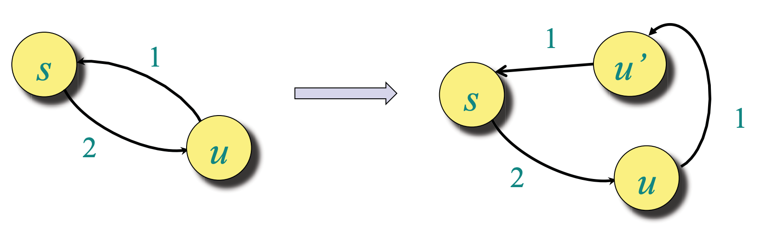
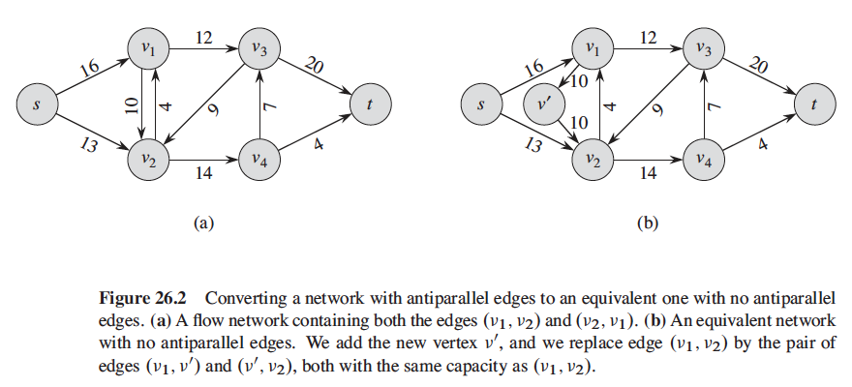
Flow networks
If there are two edges (u,v) and (v, u), we can easily fix this by introducing a new node (here the fig introduces v’)

Slide 6
Flow
Let G = (V, E) be a flow network with a capacity function c. Let s be the source of the network, and let t be the sink. A flow in G is a real-valued function f: V X V -> R satisfying the following properties:
capacity constraints: for all u, v ∈ V, f(u, v) ≤ c(u, v)
flow conservation: for all u ∈ V - {s, t} -> ∑ f(u, v) = 0
Or simply said - “whatever flows in flows out”
skew symmetry: for all u, v ∈ V, f(u, v) = - f(v, u)

Slide 7
Properties of flow
|f| = ∑ f(s, v) = f(s, V)
All flow push from the source to each vertices equal to the summation of flow of all vertices
f(X, X) = 0
f(X, Y) = -f(Y, X)
f(X U Y, Z) = f(X, Z) + f(Y, Z) if X ∩ Y ≠ ∅
Prove |f| = f(s, V) = f(V, t)
Simply said, what goes out from the source should get into the sink, or another word, not violating capacity or conservation law
Proof:
|f| = f(s, V) = f(V, V) - f(V - s, V)
|f| = f(s, V) = 0 - f(V - s, V)
|f| = f(s, V) = f(V, V - s)
|f| = f(s, V) = f(V, t) + f(V, V - s - t)
|f| = f(s, V) = f(V, t) - f(V - s - t, V)
|f| = f(s, V) = f(V, t) + 0 // according to flow conservation

Slide 8
Maximum Flow
We are interested to maximize the flow from source s and put to the sink t
You can imagine the source to be a top of the mountain and sink as the sea, with the edges to be the rivers size which has its own capacity to carry the water flow and vertices to be some small river bank
For example, in the previous picture, we got a flow of 3 to t. Is is possible to increase the flow, given that the capacities constraints are fixed?

Slide 9
Maximum Flow
flow: capacity
By making some changes of the flow, under the same capacities constraints, we have increase the flow to 4
The question is how to find the maximum flow?
A
2:2
B
2: 3
2:3
S
0:1
t
0:3
0:3
2:2
2:2
C
D
2:3

Slide 10
Residual Network
G_{f}(V, E_{f}): strictly positive residual capacities such that c_{f}(u,v) = c(u, v) - f(u, v) > 0
Edges in E_{f} admit more flow
If (v, u) ∉ E, c(v, u) = 0, but f(v, u) = -f(u, v)
G -->
G_{f} -->
A
2:2
B
A
2
B
2
2:3
2
1: 3
1
1
1
1
S
t
S
2
t
1:3
1:3
1
1:1
1
2
2:2
1:2
2
1
1
C
D
C
D
2:3
2

Slide 11
Ford-Fulkerson
Look for augmenting paths in G_{f}
Perform depth first search, find a path from s to t, if there is a path, the flow is not maximum. If no path exists, the flow is maximum and we are done
Here, there is a path S -> A -> C -> D -> t, where the min edge (residual) is 1, meaning one more can be pushed, thus along the path, we simply increase/decrease 1 along this path, we will get maximum flow
2
A
2:2
B
A
B
2
2:3
2
1
2: 3
1
1
1
S
2
t
S
t
1
0:3
1:3
1
2
1:1
2
1
1
2:2
2:2
C
D
C
D
3:3
2

Slide 12
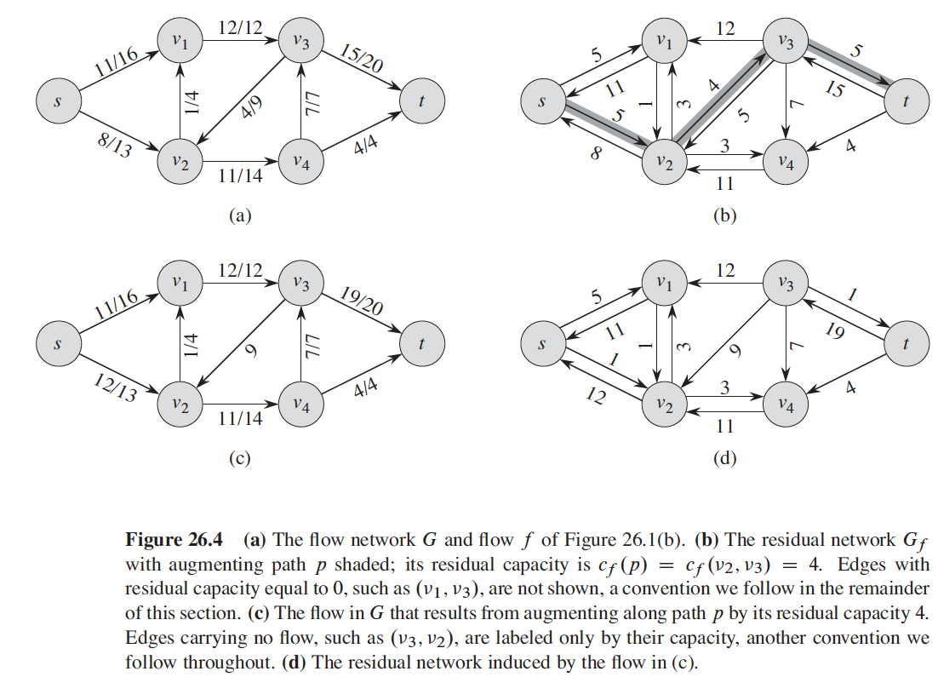
Ford-Fulkerson - another example

Slide 13
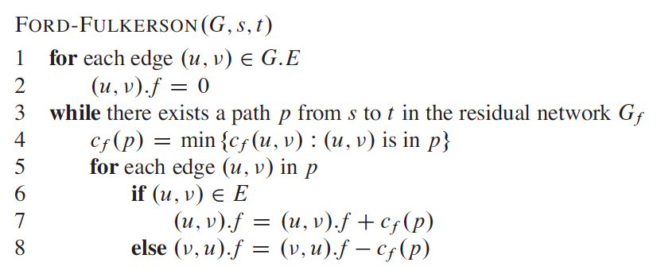
Ford-Fulkerson - pseudocode
Line 3 runs O(V + E’) = O(E) times
The while loops runs at least max|f| times. Since the smallest residual is 1, thus it could run max |f| times
Thus the total time is O(E * max |f|)

Slide 14
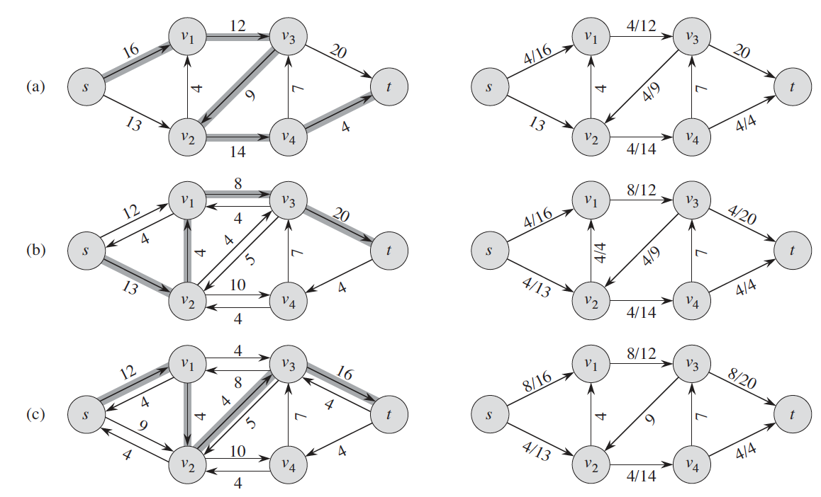
Try

Slide 15
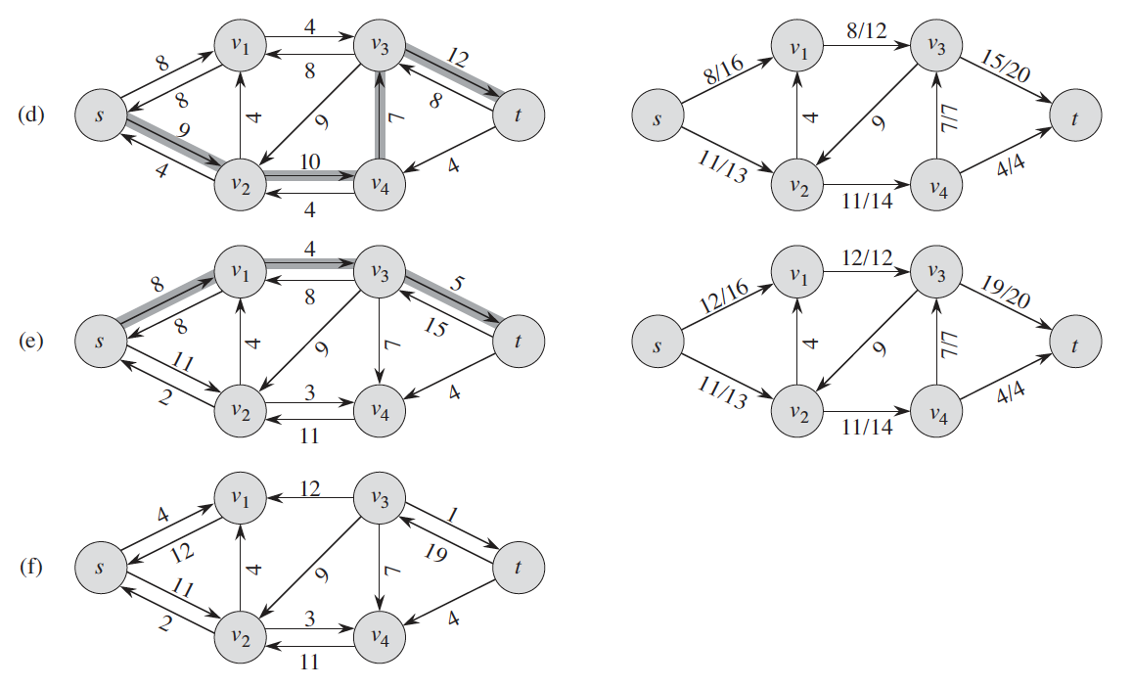
Try

Slide 16
Appendix: Cut

Slide 17
Cut
A cut (ŝ, T) of a flow network G = (V, E) is a partition of V, such that s ∈ŝ and t ∈ T. If f is a flow on G, then the flow across the cut is f(ŝ, T), giving you two disjoint components
The cut does not have to be contiguous
Only constraint is that source and sink should be on different side of the partition
Flow of a cut
f(ŝ, T) = f(S, A) + f(S, C) + f(B, A) + f(B, D) + f(B, t) + f(B, C)
= 2 + 2 -2 - 1 + 2 + 1 = 4
Capacity of a cut
c(ŝ, T) = c(S, A) + c(S, C) + c(B, t) + c(B, C)
= 3 + 2 + 3 + 1 = 9
Value of any flow is bounded by the capacity of any cut
A
2:2
B
= ŝ
2: 3
2:3
= T
S
1:1
t
0:3
1:3
2:2
2:2
C
D
3:3

Slide 18
Cut
Lemma: For any flow f and any cut (ŝ, T), we have |f| = f(ŝ, T).
Proof:
f(ŝ, T) = f(ŝ, V) - f(ŝ, ŝ)
f(ŝ, T) = f(ŝ, V) - 0
f(ŝ, T) = f(s, V) + f(ŝ-s, V) // ŝ does not contain t, and does not contain s, thus 0
f(ŝ, T) = f(s, V) = |f|
We now got ways of figuring out what the maximum flow of the network would be by making arbitrary cuts of the network and looking for the capacities of these cuts. The capacity of any cut will bound the flow of the network. In another words, I just need to find the min cut as it will bound the max flow

